Slide 1
Azure Automated Machine Learning Introduction
Cesar De la Torre Principal Program Manager
Azure Machine Learning product group
Microsoft Corp.
Email: cesardl@microsoft.com
Twitter: @cesardelatorre
AI Platform Team

Slide 2
Agenda
What is Azure Automated ML
Why automated ML?
Supported ML Tasks (ML Problems)
Demo (UI and notebooks)
Heading to MLOps/DevOps for ML and other topics
How to Get Started

Slide 3
Azure Machine Learning service
Bring AI to everyone with an end-to-end, scalable, trusted platform
Built with your needs in mind
Boost your data science productivity
Today’s talk
Automated Machine Learning
Managed compute
Increase your rate of experimentation
DevOps/MLOps for machine learning
Simple deployment
Tool agnostic Python SDK
Deploy and manage your models everywhere
Support for open source frameworks
Seamlessly integrated with the Azure Portfolio

Slide 4
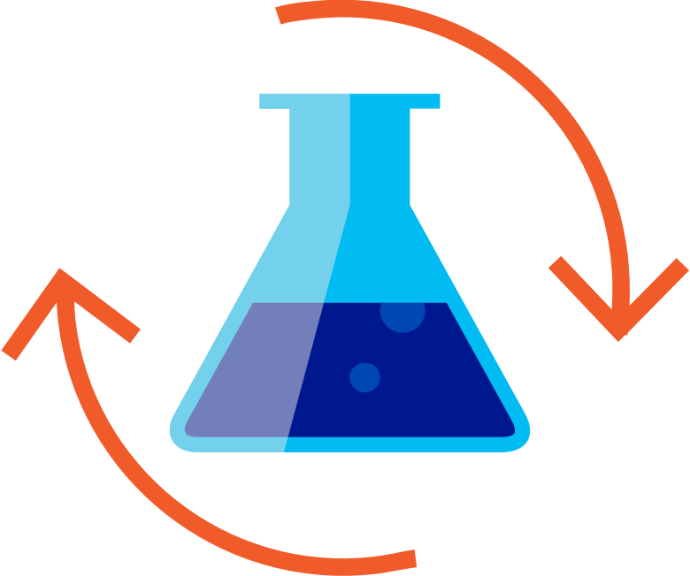

Machine Learning Process
Files
Data lake
Blob storage
SQL DB
Cosmos DB
Datawarehouse
…
Prepare Data
Build & Train
Deploy
Notes:
As a data scientist I will
Start with my data – usually I will have it stored in a blob store or Datawarehouse
And then comes the data preparing stage where I will be normalizing the values, imputing any missing values, getting rid of columns that wont contribute
Begin modeling with algorithms and hyper parameters that I think will work well based on my prior knowledge
Once I am satisfied, I’ll deploy the ML model to production (to be used/consumed by the end-user application)

Slide 5
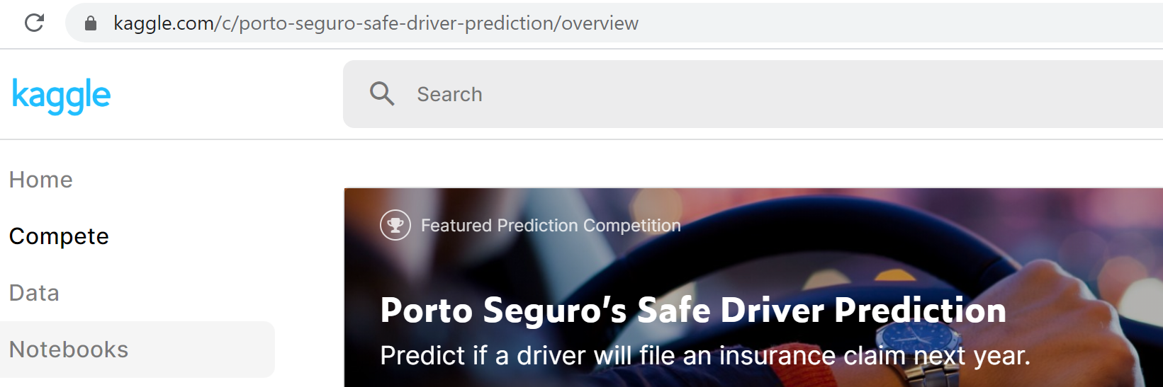
Machine Learning Problem Example
Will a customer/driver file an insurance claim next year?
(‘Safe Driver’ Prediction)
Kaggle Competition: “Porto Seguro’s Safe Driver Prediction”
https://www.kaggle.com/c/porto-seguro-safe-driver-prediction/overview
Notes:
This is a canonical example. Similar examples could be:
How much is this house worth?
How much is this taxi trip worth?
Let’s walk through a simple problem, and see what factors a data scientists may consider along the way. Here we’ll ask the question- “How much is a car?”

Slide 6
Model Creation Is Typically Time-Consuming
Which features?
Which algorithm?
Which parameters?
Driver Address
Driver Age
Max Mileage Year
Engine Power
Driver Phone number
…
Gradient Boosted
Nearest Neighbors
SVM
Bayesian Regression
LGBM
…
Parameter 1
Parameter 2
Parameter 3
Parameter 4
…
Driver Address
Gradient Boosted
Criterion
Loss
Min Samples Split
Min Samples Leaf
Others
Max Mileage Year
Engine power
30%
Model
Notes:
When trying to answer this question, a data scientists may ask:
What features should I consider?
Mileage, condition, car brand?
Then what algorithms should I apply to my problem?
Finally our data scientists will decide on the parameters for each model and receive a score, in this case 30% accuracy.

Slide 7
Model Creation Is Typically Time-Consuming
Which features?
Which algorithm?
Which parameters?
Max Mileage Year
Driver Age
Car brand
Year of make
Driver Address
…
Gradient Boosted
Nearest Neighbors
SVM
Bayesian Regression
LGBM
…
Criterion
Loss
Min Samples Split
Min Samples Leaf
Others
Max Mileage Year
Gradient Boosted
N Neighbors
Weights
Metric
P
Others
Driver Age
Nearest Neighbors
Engine Power
Engine Power
50%
Car Color
30%
Car Color
Model
Iterate
Notes:
This isn’t very good, so we choose a different set features, a different algorithms and parameters and get a slightly better accuracy, and we will keep doing this until we receive a score we’re happy with- say 95%.

Slide 8
Model Creation Is Typically Time-Consuming
Which features?
Which algorithm?
Which parameters?
30%
50%
70%
30%
45%
50%
65%
95%
35%
10%
75%
20%
70%
30%
15%
Iterate
Notes:
We can see how this process very quickly because iterative, repetitive, and time consuming and there has to be a better way to do this. This is exactly where AutoML & Hyperdrive comes in.

Slide 9
Demo – The traditional and “manual” ML approach Safe Driver Prediction
Example: LGBM model notebook, Python code, still NO Azure AutoML
https://github.com/Azure-Samples/AzureMLWorkshop/blob/master/notebooks/Challenge01.A/porto-seguro-safe-driver-prediction-LGBM.ipynb
List of supported algorithms in Azure AutoML

Slide 10
What if we can simplify machine learning?
Notes:
The current process needs practitioners who are skilled in ML such as data scientists.
What if we can simplify this process?
What if we can enable those who are novice in the area to create machine learning models?
What is we can enable those same skilled professionals to be more efficient and productive?

Slide 11

What is Automated Machine Learning?
Automated machine learning (automated ML) automates feature engineering, algorithm and hyperparameter selection to find the ‘best model’ for your data.
User inputs
Feature engineering
Algorithm selection
Hyperparameter tuning
Model Leaderboard
Rank | Model | Score
1 |  | 95%
2 |  | 76%
3 |  | 53%
Dataset
76% | 34% | 82%
41% | 88% | 72%
81% | 54% | 73%
88% | 90% | 91%
95% | 68% | 56%
89% | 89% | 79%
…
Configuration & Constraints
List of supported algorithms in Azure AutoML
Notes:
Input: To leverage Automated ML:
users come with their data
can specify a number of configurations and constraints-
such as how long to run an experiment
early termination when we reach a score you’re satisfied with
and more
Feature Engineering:
Impute missing values in your data
Addition of engineered features:
i.e.
holiday data, quarter, week of year, month, day and more for datetime values in your forecasting data
Algo selection + Hyperparameter tuning:
We iterate over many different models
The model types depend on your ML task
For each model we perform hyperparameter tuning
Model Leaderboard:
We return to you’re a model leaderboard, with emphasis on the best model

Slide 12



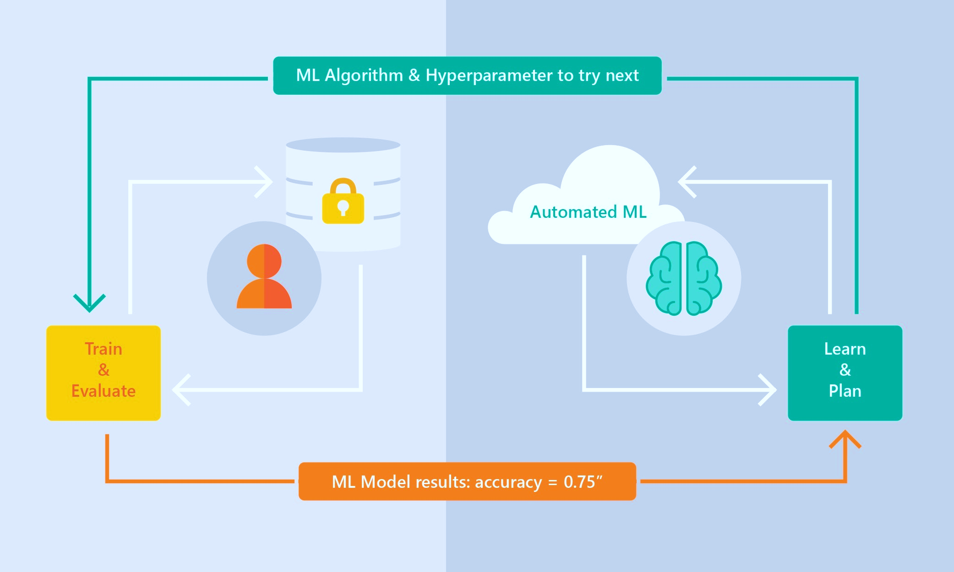
Automated ML – How it works
Supervised Learning
Classification
Regression
Time Series Forecasting
ML Tasks supported:
Classification Regression and Time-Series Forecasting
Based on Microsoft Research
Brain trained with millions of experiments
Privacy preserving: No need to “see” the data

Slide 13
Demo – Azure Automated ML Safe Driver Classification model
Automated ML using the UI in Azure ML studio
Automated ML using the Azure ML SDK (Jupyter Notebook)
https://github.com/Azure-Samples/AzureMLWorkshop/blob/master/resources/References/Challenge02.B/Challenge02.B-AutoML-Remote-AML-Compute-porto-seguro.ipynb
Notes:
Add pointers to demos

Slide 14
Additional topics not covered today: - MLOps and Model Lifecycle (AML pipelines integration to Azure DevOps) - Model Explainability (Out-of-the-box model explainability in AutoML) - NLP/DNN Featurization (Deep-Learning based featurization for Text) - AML infrastructure (Workspace, Datasets, Environments, etc.) - Other ML Tasks (Regression, Time-Series Forecast, Classification) - ‘Many Models’ (Hundreds or thousands of models trained in parallel) - Deep Learning (Image Labeling, Classif., Obj-Detection)
Notes:
Add pointers to demos

Slide 15


Try it for free http://aka.ms/amlfree
Learn more : https://aka.ms/automatedmldocs
Notebook Samples : https://aka.ms/automatedmlsamples
Blog: https://aka.ms/AutomatedML
The studio: https://ml.azure.com
Try Automated ML: https://aka.ms/tryautomatedml
Product Feedback : AskAutomatedML@microsoft.com
Notes:
Choose between visual drag-and-drop or code-first authoring with complete control
Use your favorite IDE, built into your favorite IDE (VS Code only @ Public Preview)
Use any framework or library and the most popular languages
Faster, easier training on industry leading Spark

Slide 16
Thank you.
Cesar De la Torre Principal Program Manager
Azure Machine Learning product group
Microsoft Corp.
Email: cesardl@microsoft.com
Twitter: @cesardelatorre

Slide 17
Appendix

Slide 18




MLOps with Azure Machine Learning
Collaborate
App developer
using Azure DevOps
Train model
Validate model
Deploy model
Monitor model
Audit trail management and model interpretability
Data scientist using
Azure Machine Learning
Retrain model
Model reproducibility
Model validation
Model deployment
Model retraining

Slide 19

Best pattern: Multiple pipelines to manage the E2E process
Train Model
Data Scientist
Prepare Data
Data Catalog
Featurize
Train
Evaluate
register
Model Registry
Data Engineer
Release Model
release
Data Lake
Package
Validate
Profile
Approve
Deploy
collect
ML Engineer
Notes:
Starts small as the Data Scientist inner loop
First conversations are about data availability
Then about experimentation velocity
Then about operationalization

Slide 20
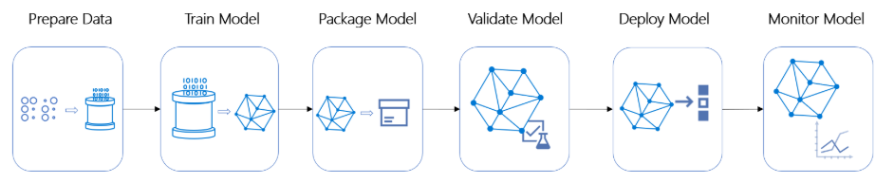



Azure ML Pipelines within the e2e model lifecycle
Azure Machine Learning pipelines allow you to create workflows in your ML projects.
Those pipelines can later be triggered from external operationalization orchestrators such as Azure DevOps CI/CD
Azure Data Factory
Azure ML Pipeline
Azure DevOps Release
Azure ML
Azure DevOps (End-to-end lifecycle)
Notes:
Talking points:
Main benefits of AML Pipelines:
Repeatability
Flexibility
Versioning and tracking
Modularity
Integration (i.e. Azure DevOps)
Azure ML Pipelines are modular and composed by multiple steps. For instance, you can see a possible AML Pipeline composed by the following steps:
Train
Package Model
Validate Model
On top of the AML Pipeline level you can orchestrate the multiple workflows with Azure DevOps pipelines (note that those are a different type of pipelines which can trigger AML Pipelines). That includes triggering AML Pipelines but also other workflows like data preparation based on Azure Data Factory or internal Azure DevOps Release/Deployment pipelines deploying models as services into AML.

Slide 21
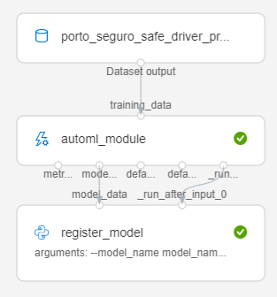
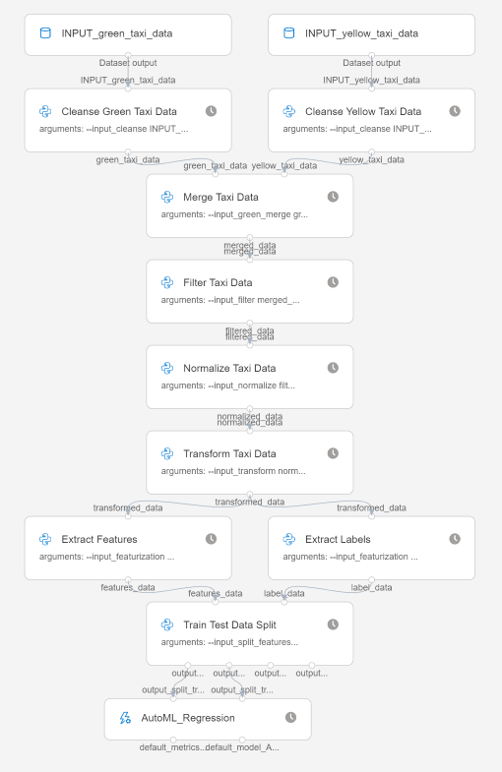

AutoMLStep within Azure ML Pipelines
AML Pipelines
AutoMLStep provides an easy way to encapsulate AutoML configuration and training code as an AML Pipeline step.
Typical code refactoring process:
Initial code: Explore/define your regular AutoML code in Jupyter notebooks
AML Pipelines: Evolve/refactor code into decoupled pieces of code:
PythonScriptStep with .py script for each data transforms & AML SDK code
AutoMLStep for encapsulating AutoML as a pipeline step
CI/CD for ML: Integrate with higher level model lifecycle in Azure DevOps
Example 1:
AutoMLStep
AutoML training
Example 2:
Data Science
(Azure AutoML)
Componentization
(Azure ML Pipelines)
CI/CD lifecycle
(Azure DevOps)
AutoMLStep
1.
2.
3.

Slide 22



Automated ML Data Requirements
A single source for training:
Tabular and flat data
Sources: local upload, blob, datalake, Azure SQL Database, web source (ex. Dataset files at GitHub), or anything in a Pandas dataframe
Notes:
We expect a single flat dataset – if columns aren’t names we will name them as “column 1, column 2…”

Slide 23
Data
[New] Large data
[New] Azure Open Datasets
Data Guardrails
Notes:
Data
Large data
Value prop: supporting machines learning scenarios without compromise
Support 100 GB, 1 TB coming soon
Enrich data - Azure Open Datasets
Value prop: Enrich your datasets with curated open data easily accessible on Azure. Additional data can improve the quality of your models.
Example: Creating a predictive model to forecast sales on a retail store. Weather data, holiday data can impact. Add it from Azure Open Datasets.
Other specific examples: public holidays, historical weather, US population, etc.
Guardrails on data
Checking for class imbalance
High cardinality columns

Slide 24
Featurization
[New] Deep Learning
[New] Custom Featurization
Automatically engineer features
Automated pre-processing of data
Notes:
Featurization
Current: supports some automatic featurization and feature engineering
Deep learning with Bert and BiLSTM for NLP
Fun fact: Recently, Allen Institue for AI announced new language understanding system called Aristo https://allenai.org/aristo/. The system has been developed for 20 years, but it's performance was stuck at 60% on 8th grade science test. The result jumped to 90% once researchers adopted BERT as core language understanding component.
Value prop: now available to your scenarios with a click of a button
Customization
Value prop: Enable data scientists with knowledge on how the data contribute to the model, resulting in better accuracy
Block transformers
Override column purpose
Choose to include or exclude columns in training
Decide how to impute missing values
Advanced data preprocessing and feature engineering information:
https://docs.microsoft.com/en-us/azure/machine-learning/service/how-to-create-portal-experiments#advanced-preprocessing-options

Slide 25

Training
Current ML Tasks supported:
Classification
Regression
Time-Series Forecast
[New] Additional Forecasting Learners
[New] ’Many Models’
Notes:
adding world class statistical models like arima , prophet and deep learning models like TCN.
We try all of these along with our classical models on the users dataset to provide better performance.
Many models. Now instead of having one model to forecast for your entire store, we are introducing grouping which is our first step towards hierarchical time series. This will allow for more detailed forecasts

Slide 26

Interpretability
[New] Interpretability Dashboard
Transparent modeling process
Notes:
Top two questions
What did you do?
Now I have a model, but how did automated ml build it? You’re saying everything is automated and will be taken care of, but what did you really do?
Show transformers, parameters
any values we altered in the dataset (impute missing values, train-valid), algorithm and hyper parameters.
How are predictions made?
How is the model making decisions? How does the way the model makes decisions align with your prior business knowledge on the problem?
Interpretability dashboard
Example: employee retention
Feature importance, local and global. Training and inference time
What if analysis (employee retention)
Training time and inference time
+ interpretability dashboard

Slide 27
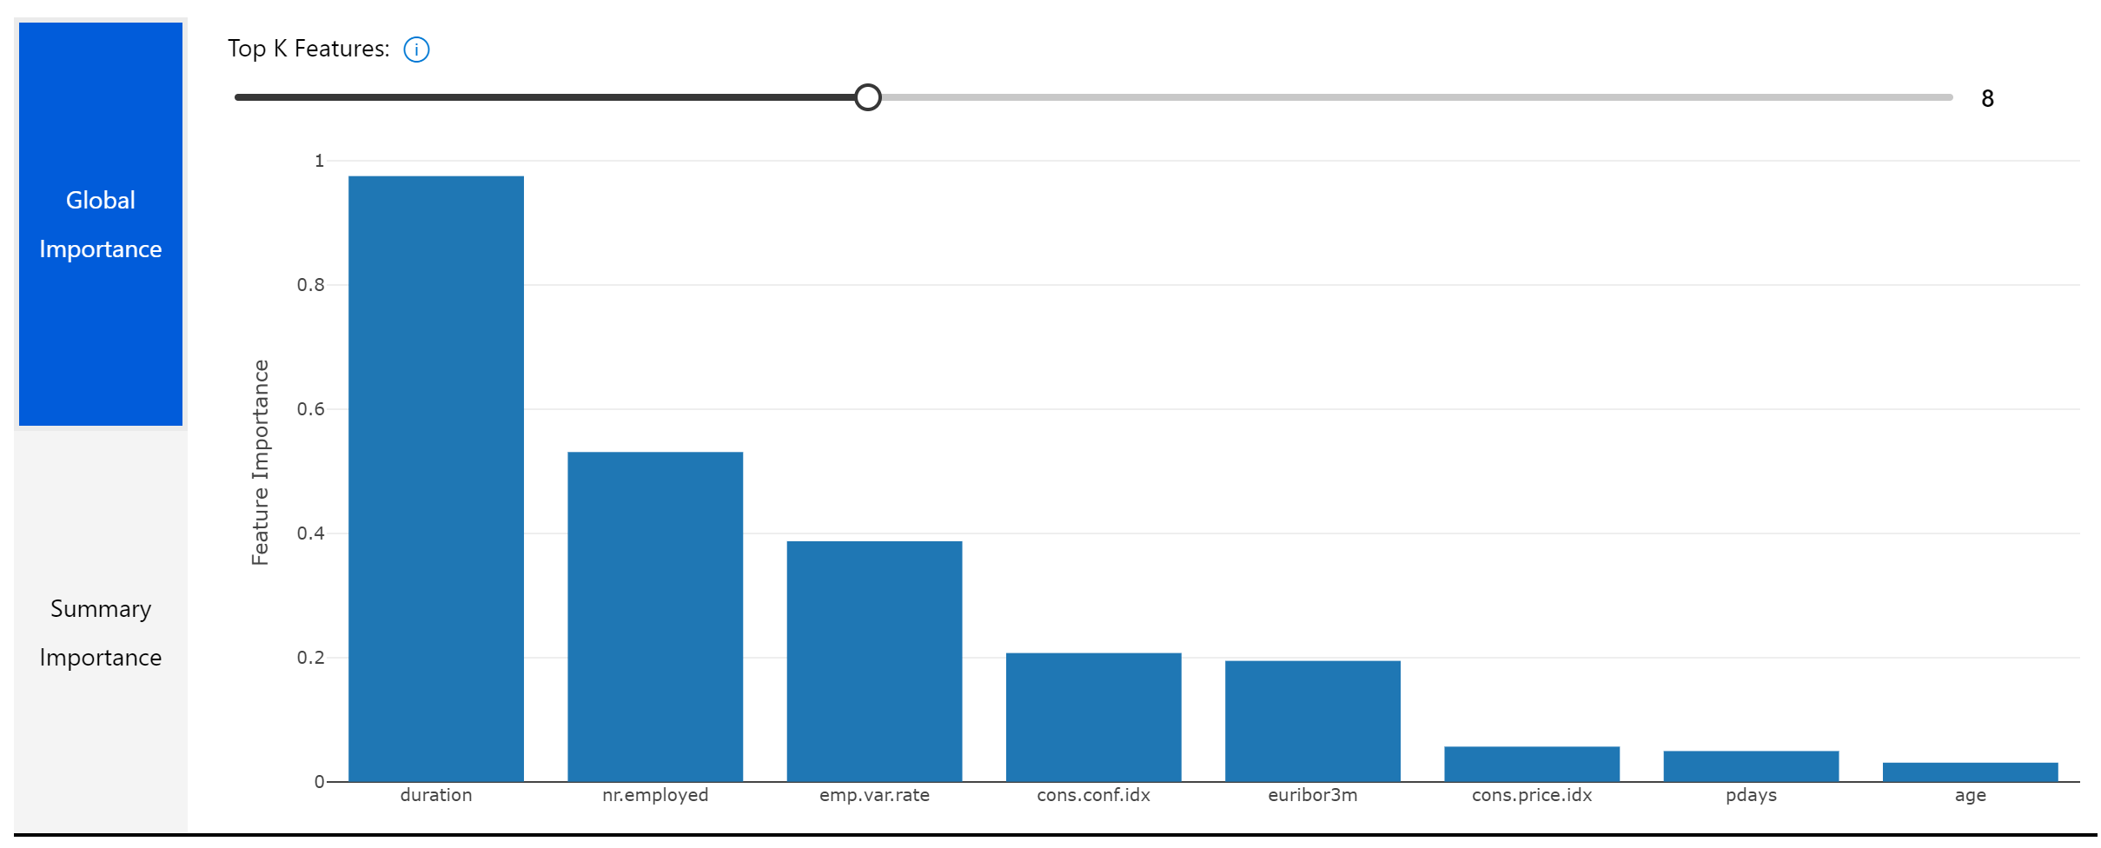

Slide 28
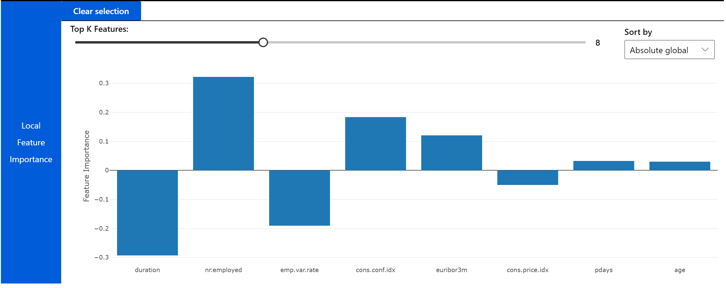

Slide 29
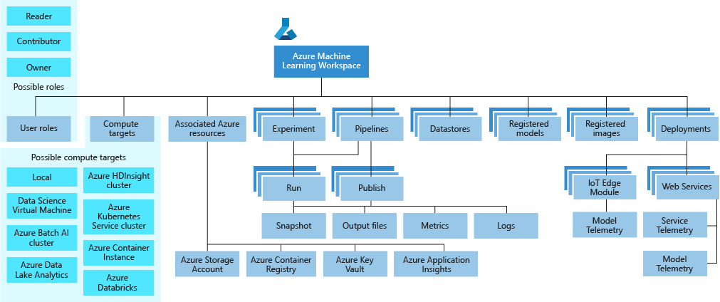
Azure ML service Workspace Taxonomy

